Slide 1
Tracking Tomato Plant Growth and Disease
By: Steven Le, Nitin Maddi

Slide 2
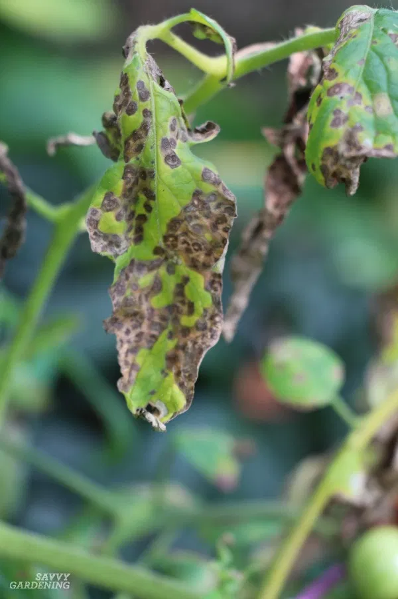
Problem
Tomato plants require constant attention
No convenient automated tool for farmers/gardeners

Slide 3
Proposal
We will create a web application that uses computer vision and machine learning techniques to inform a user of their plant’s status
Use edge detection to determine stem length
Create convolutional neural network (CNN) to determine plant health
Easy to use interface

Slide 4
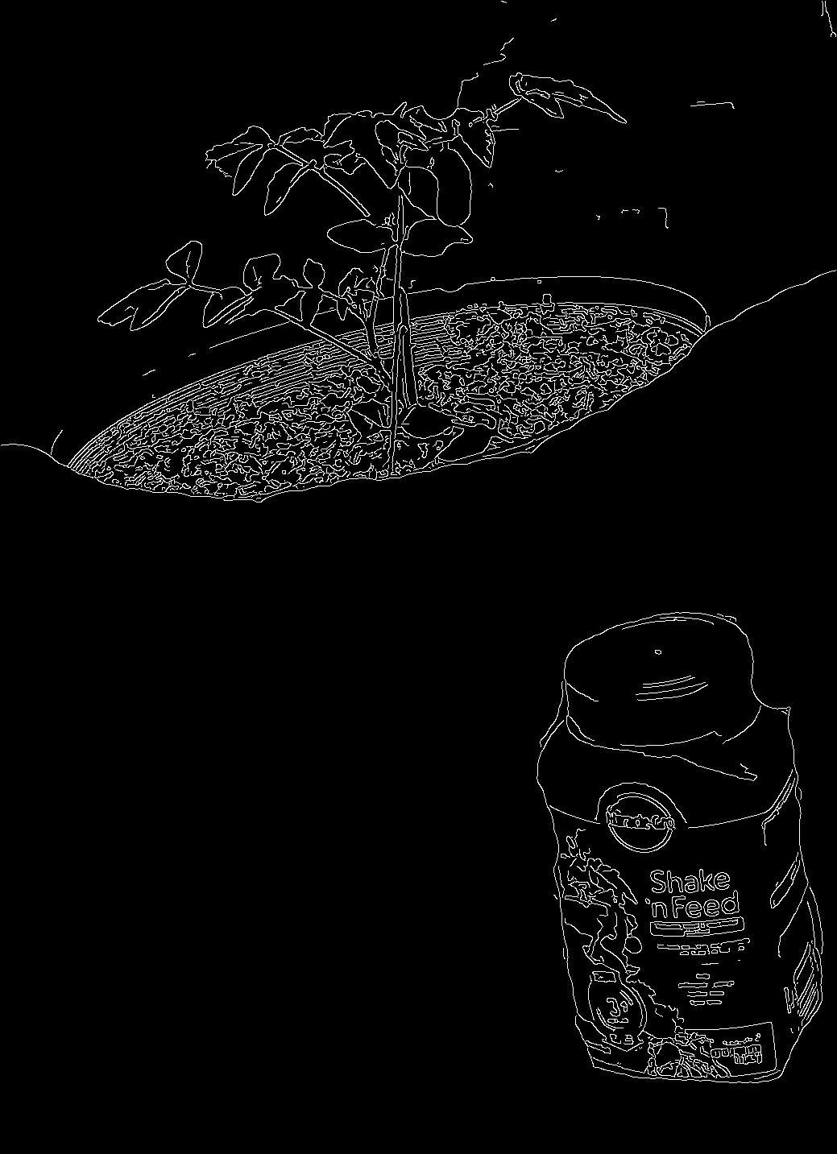
Solution
OpenCV’s CannyEdgeDetector()
Kernel size, threshold,
Dehazing
Calculate extreme values

Slide 5
What’s Next
UI
Develop Neural Network
AWS Deep Lens

